Slide 1
Phyllosphere Changes Over Growth of Canola
Emily Wahlenmayer

Slide 2

Phyllosphere microbial communities promote plant growth and resiliency
bacterial load increased with the growing season on corn leaves
Batool F, Rehman Y, Hasnain S (2016) Phylloplane associated plant bacteria of commercially superior wheat varieties exhibit superior plant growth promoting abilities. Front Life Sci 9:313–322
Notes:
Microbiome work typically focuses on rhizosphere

Slide 3
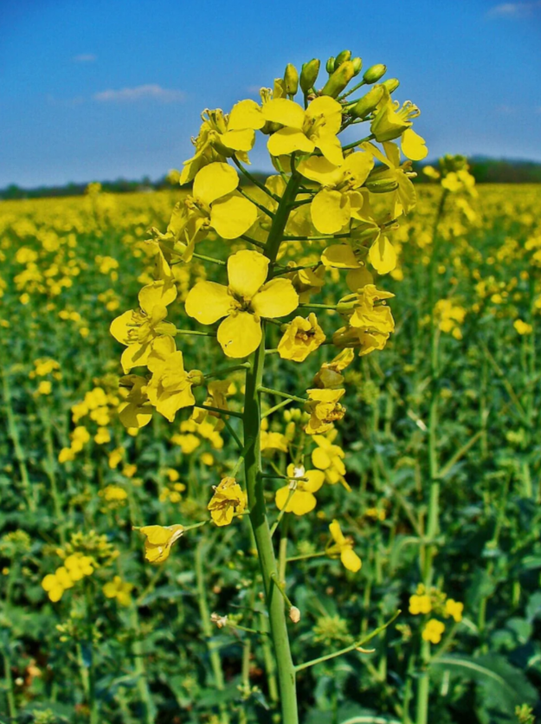
Phyllosphere breeding is a possible avenue for food security without increasing land use.
37% of all arable land is dedicated to
agriculture.
Phyllosphere breeding is a possible avenue for food security without increasing land use.
37% of all arable land is dedicated to
agriculture.
Improving yield w/o GMOs is of interest.
Canola is the most valuable crop in
Canada, producing $26-$29 billion/yr.
Ryan PR, Dessaux Y, Thomashow LS, Weller DM (2009) Rhizosphere engineering and management for sustainable agriculture. Plant Soil 321(1–2):363–383

Slide 4
Plants need different services during different growth stages; microbial roles may vary over time. The micro-niche also changes with plant development
(leaf texture, seasonal change, pest pressure)
Plants require the most services during flowering, an energy-intensive process.
Borghi M, Perez de Souza L, Tohge T, Mi J, Melandri G, Proost S, Martins MCM, Al-Babili S, Bouwmeester HJ, Fernie AR. High-energy-level metabolism and transport occur at the transition from closed to open flowers. Plant Physiol. 2022 Aug 29;190(1):319-339. doi: 10.1093/plphys/kiac253. PMID: 35640120; PMCID: PMC9434183.

Slide 5
When is the microbial richness highest?

Slide 6
How does the microbial community shift over time?

Slide 7
I hypothesize that microbial abundance and diversity is the highest around flowering stage.
expect a positive relationship between richness and time

Slide 8
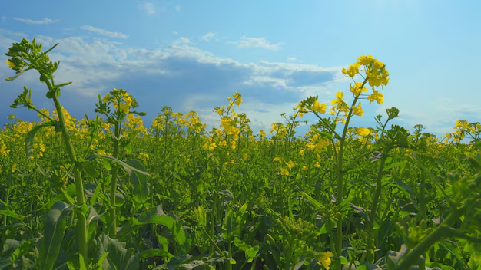
amplified the V4 region of the bacterial 16S rRNA using the 515F/806R primer set with Illumina adapters
Sequenced to 300 bp
Normalized to depth of 1200 reads, yielding 122 ASVs

Slide 9
Alpha diversity metrics show positive *block relationship
Richness differed significantly across blocks
(Kruskal–Wallis χ² = 45.4, df = 9, p < 0.001)
Diversity increased significantly across blocks for all metrics
(Spearman ρ ≈ 0.56–0.58, p < 10⁻¹¹)
Notes:
I assessed alpha diversity using Hill numbers at q = 0, 1, and 2, representing richness, common taxa, and dominant taxa, respectively.
All three diversity metrics showed significant positive relationships with block indicating that diversity increases across blocks. The slightly stronger relationship at q = 0 suggests that changes in rare taxa contribute most strongly to this trend. Richness differed significantly among blocks (Kruskal–Wallis p < 0.001).

Slide 10
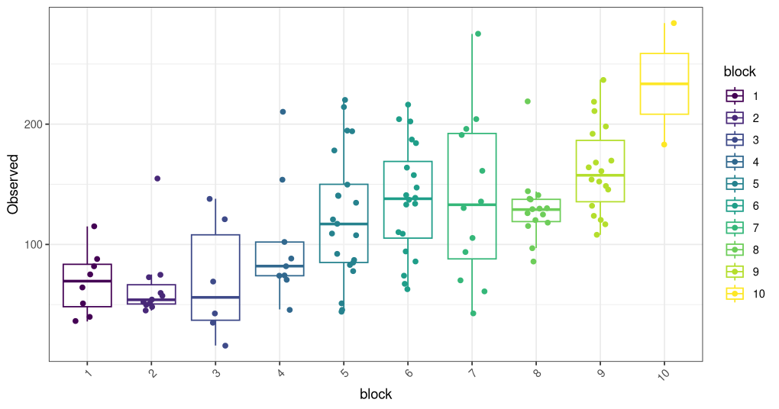
Explaining growth stages
Leafing
Bolting
Flowering
Seed developing
Ripening

Slide 11
Richness increases over time
rho 0.5624032
p_value 1.570530e-11

Slide 12
Richness increases over time
Leafing
Bolting
Flowering
Seed developing
Ripening
rho 0.5624032
p_value 1.570530e-11

Slide 13

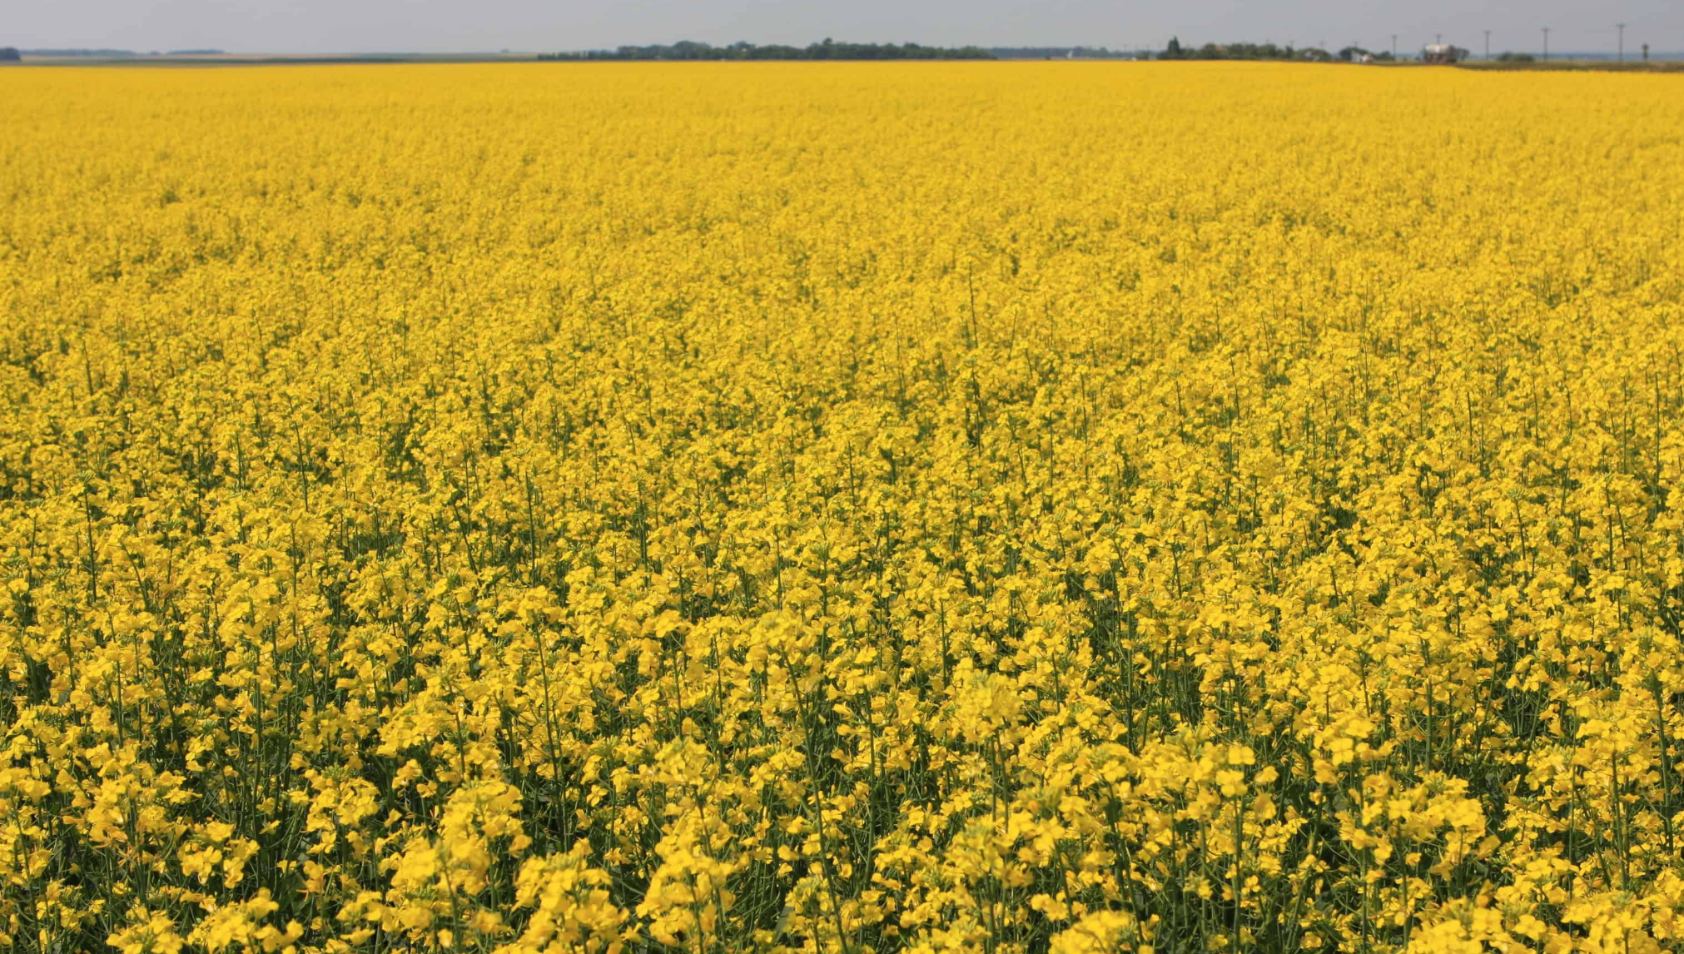
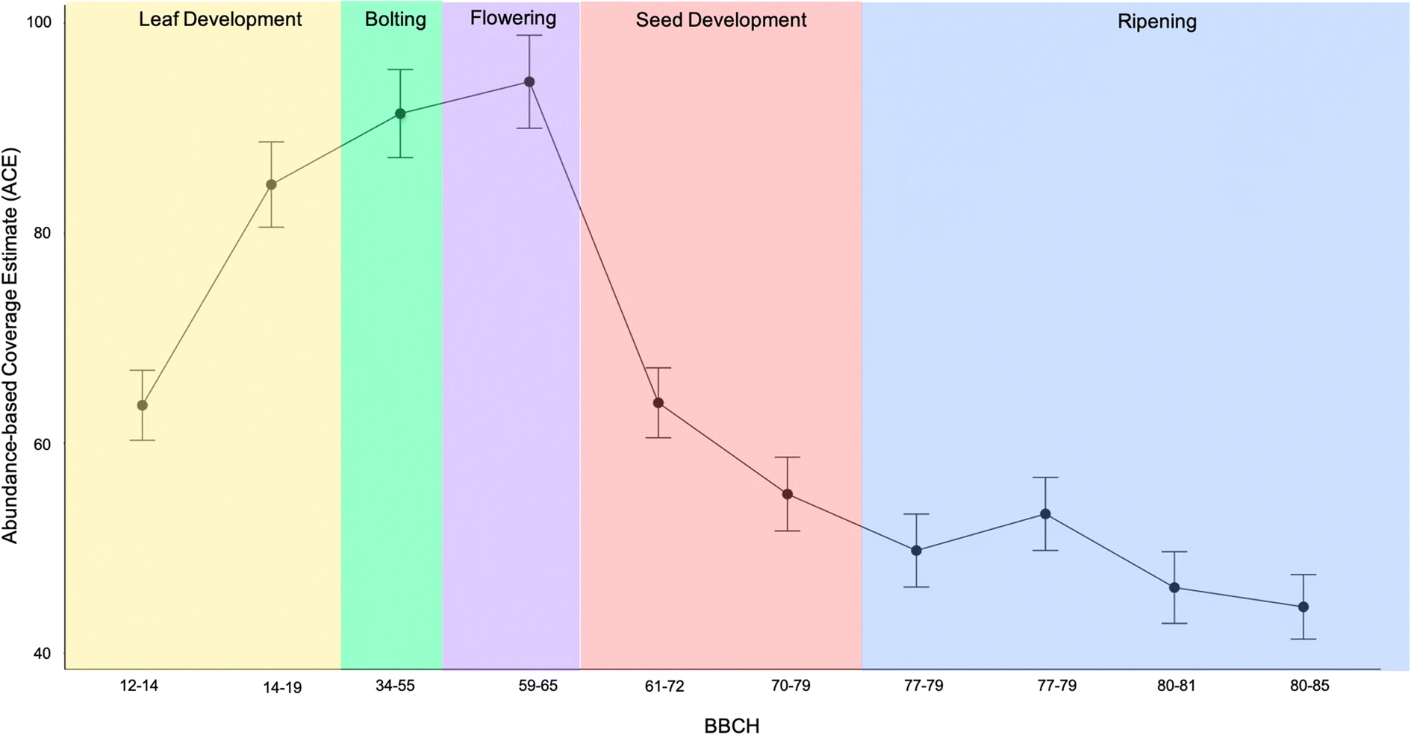

Slide 14
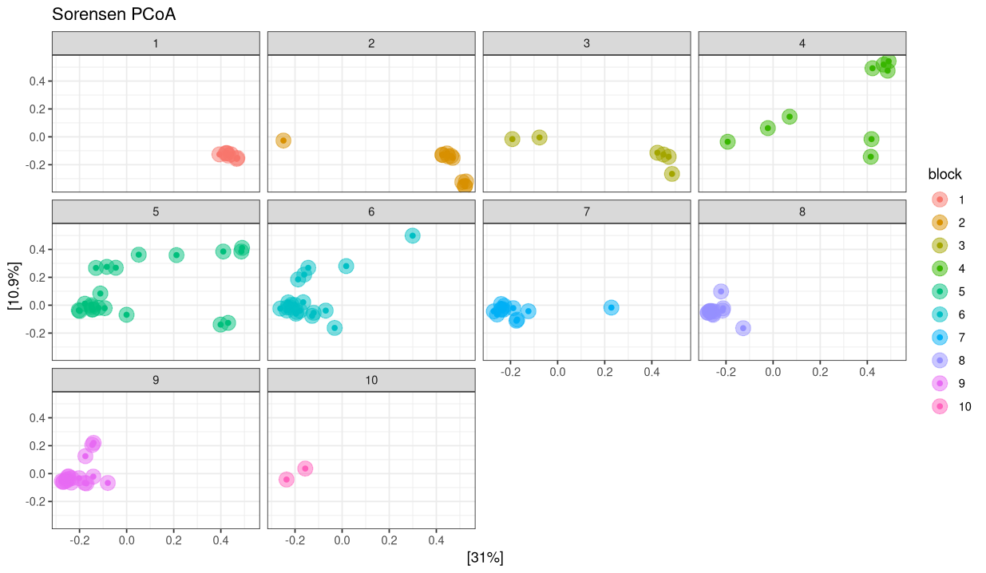
A turnover of taxa between blocks is seen in Sorenson, suggesting rare taxa are more transient. They may change more frequently from environmental pressures.
Bray-Curtis suggests that relative abundance is more conserved than species presence/absence.
PERMANOVA
Sorensen:
R² = 0.192
F = 28.46
p = 0.001
Bray-Curtis:
R² = 0.155
F = 22.09
p = 0.001
Notes:
PCoA shows difference in samples between blocks, with block explaining ~20% of the variation in relative abundance and ~30% in presence/absence, meaning block is a major factor in determining community structure.
The betadisper was significantly different, meaning there is heterogeneity in the dispersion… some time points had more variation than others.
PERMANOVA confirmed that block significantly influenced community composition

Slide 16
Dominant taxa are relatively consistent across samples, while rarer taxa contribute more to differences in community composition

Slide 17
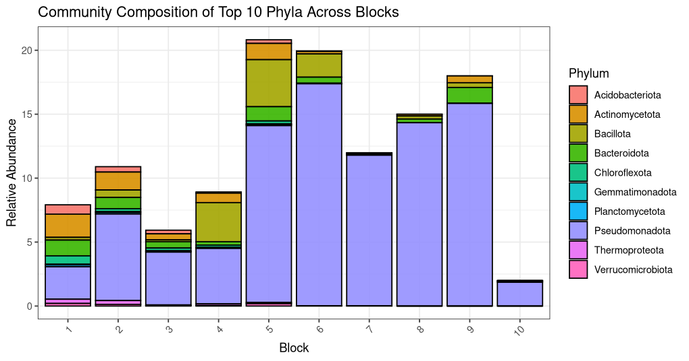

Slide 18
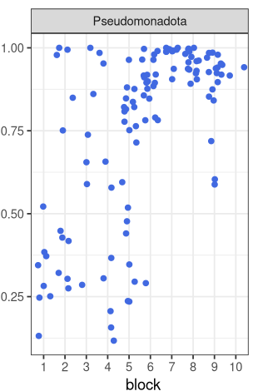

Slide 19
Leafing
Bolting
Flowering
Seed developing
Ripening
Notes:
Antifungal, antibacterial, nitrogen-fixing

Slide 20
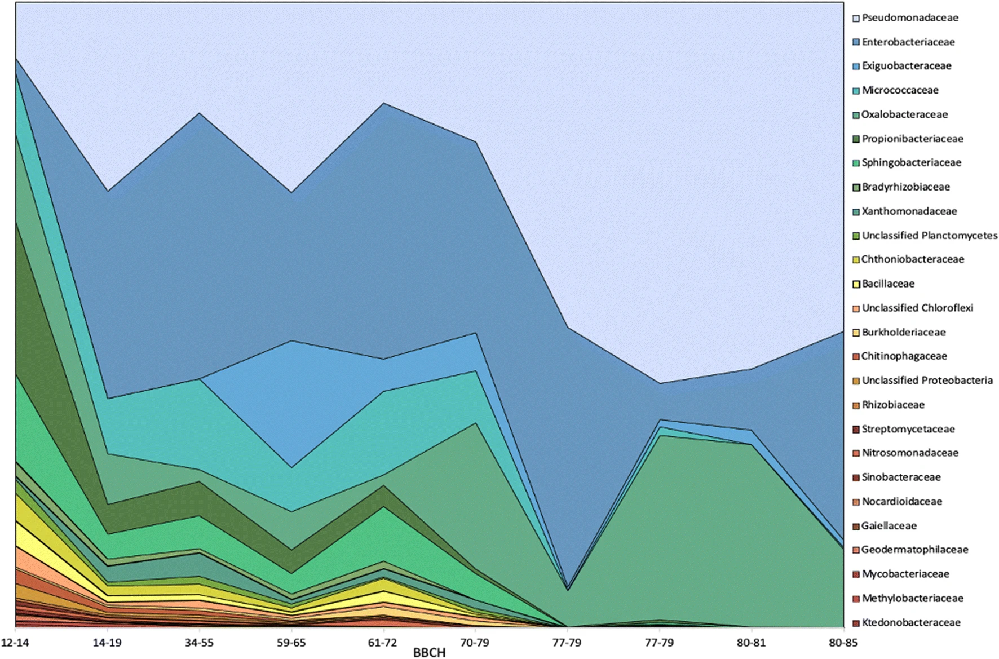
Relative abundance of genera that composed the Core as well as the communities present during the Flowering and Pod stages (Expanded Core).

Slide 21
Relative abundance of genera that composed the Core as well as the communities present during the Flowering and Pod stages (Expanded Core).

Slide 22
“Core”/Top 10 match between studies
Pseudomonadota: pathogens, nitrogen-fixing, antifungal, methanogens
Bacteroidota: biomass breakdown, soil quality
Acidobacteria: early growth factors, nutrient cycling
Bacillota: biocontrol
Actinomycetota: antifungal
Chloroflexota: decomposers
Thermoproteota: stress adaptation, heat-adapted
Verrucomicrobiota: stress adaptation, biocontrol
Planctomycetota: stress adaptation, nutrient cycling, leaf niche
Gemmatimonadota: drought tolerance
Pseudomonadota (79%)
Bacteroidota (7%)
Acidobacteria (6%)
Bacillota (6%)

Slide 23
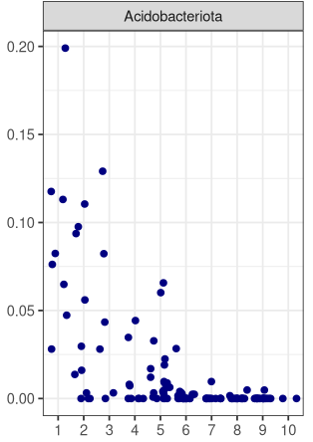
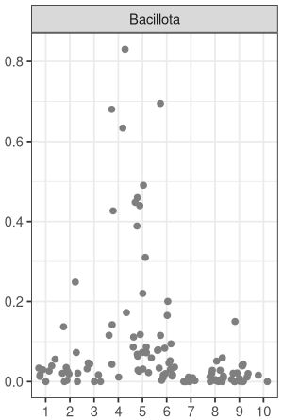
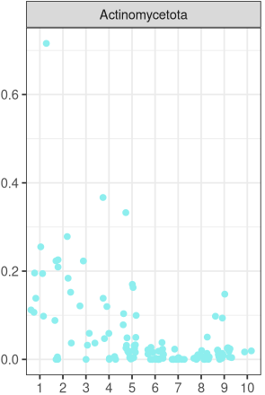

Slide 24
The phyllospheric microbiome does change
according to growth stage.
Pseudomonadota increases over time
Actinomycetota decreases during budding
Bacillota is present during flowering
Abundance is decreased after ripening

Slide 25
Plants may play an active role in building their
microbial community, and the dynamics may have
co-evolved into a complex mutualistic web.
Notes:
Future hypotheses and avenues to explore

Slide 26
Bell, J.K., Helgason, B. & Siciliano, S.D. Brassica napus phyllosphere bacterial composition changes with growth stage. Plant Soil 464, 501–516 (2021). https://doi.org/10.1007/s11104-021-04965-2
Batool F, Rehman Y, Hasnain S (2016) Phylloplane associated plant bacteria of commercially superior wheat varieties exhibit superior plant growth promoting abilities. Front Life Sci 9:313–322
Borghi M, Perez de Souza L, Tohge T, Mi J, Melandri G, Proost S, Martins MCM, Al-Babili S, Bouwmeester HJ, Fernie AR. High-energy-level metabolism and transport occur at the transition from closed to open flowers. Plant Physiol. 2022 Aug 29;190(1):319-339. doi: 10.1093/plphys/kiac253. PMID: 35640120; PMCID: PMC9434183.
Guo B, Zhang H, Liu Y, Chen J, Li J.2023.Drought-resistant trait of different crop genotypes determines assembly patterns of soil and phyllosphere microbial communities. Microbiol Spectr11:e00068-23.https://doi.org/10.1128/spectrum.00068-23
Khan MA, Asaf S, Khan AL, Jan R, Kang SM, Kim KM, Lee IJ. Thermotolerance effect of plant growth-promoting Bacillus cereus SA1 on soybean during heat stress. BMC Microbiol. 2020 Jun 22;20(1):175. doi: 10.1186/s12866-020-01822-7. PMID: 32571217; PMCID: PMC7310250.
Mamani-Rojas, L., Rengifo, R., Velarde-Apaza, L., Ramírez-Rojas, M., & Cántaro-Segura, H. (2026). Biocontrol and Plant Growth-Promoting Potential of Bacillus and Actinomycetes Isolated from the Rhizosphere and Phyllosphere of Potato (Solanum tuberosum L.) from Different Agroecological Zones of Peru. Applied Microbiology, 6(1), 2. https://doi.org/10.3390/applmicrobiol6010002
Tsotetsi T, Nephali L, Malebe M, Tugizimana F. Bacillus for Plant Growth Promotion and Stress Resilience: What Have We Learned? Plants (Basel). 2022 Sep 22;11(19):2482. doi: 10.3390/plants11192482. PMID: 36235347; PMCID: PMC9571655.
Marta Torres, Vincent Lombard, Nicolas Terrapon, Adam M. Deutschbauer. Unraveling Fitness Landscapes in Plant-Associated Bacteroidota. bioRxiv 2025.12.01.691665; doi: https://doi.org/10.64898/2025.12.01.691665
Ryan PR, Dessaux Y, Thomashow LS, Weller DM (2009) Rhizosphere engineering and management for sustainable agriculture. Plant Soil 321(1–2):363–383
Wang D, He X, Baer M, Lami K, Yu B, Tassinari A, Salvi S, Schaaf G, Hochholdinger F, Yu P. Lateral root enriched Massilia associated with plant flowering in maize. Microbiome. 2024 Jul 9;12(1):124. doi: 10.1186/s40168-024-01839-4. PMID: 38982519; PMCID: PMC11234754.

